Slide 1
Applying naïve sentimental analysis to conversion narratives
Jaden Long

Slide 2
The big question
Do all conversion narratives follow a similar pattern?
i.e. Are they cliché in their way of telling the story?
If yes, then there is a good chance of the stories being edited or just made up altogether for the purpose of religious propaganda

Slide 3
Dividing the question down
Conversion narratives might all follow the storyline of
A person having a bleak life, scorned by others
This person sees the great promises of conversion
The person has a lot of inner turmoil regarding conversion
This person converts
This person lives a great life
Hypothesis: the conversion narratives all follow a similar change in “mood”

Slide 4
My literary sources
Matters (Un-)Becoming: Conversions in Epiphanius of Salamis, A. Jacobs
Panarion, Epiphanius (also given the name Against Heresies by 16th century Latin translators)
“I. Becoming a leader: ascetics and priests”
Peter (Panarion 40)
Paulinian (Panarion 51)
“II. Becoming a heretic”
Origen (Panarion 64)
Arius (Panarion 69)
“III. Becoming a Christian”
Josephus of Tiberias (Panarion 30)

Slide 5
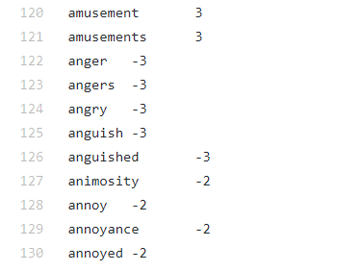
AFINN
A lexicon with common words and their “sentiment score” from -5 (very negative) to +5 (very positive)
e.g.

Slide 6
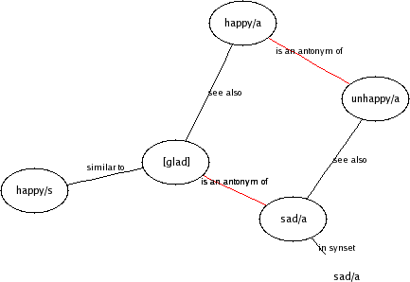
WordNet
“A large lexical database of English grouped into sets of cognitive synonyms (synsets), each expressing a distinct concept.
Synsets are interlinked by means of conceptual-semantic and lexical relations”
https://wordnet.princeton.edu/

Slide 7
A naïve algorithm: WordNet enhanced AFINN
But AFINN lexicon is made oriented toward Twitter tweets
For each of the words not in the AFINN database, we find all its synonyms and find the average AFINN score of these words
E.g. “sin” is not in the AFINN database:
Synonyms: ['sin', 'sinfulness', 'wickedness', 'sin', 'sinning', 'sine', 'sin', 'Sin', 'sin', 'sin', 'hell', 'sin', 'transgress', 'trespass', 'drop_the_ball', 'sin', 'blunder', 'boob', 'goof'] Antonyms: []
Score: -2.2

